Slide 1

A Online System For Service Of Electronic Devices (Technician)

Slide 2
TECHNICIAN
Guided By :
Mr. Bijaya Kumar Biswal
Designed By :
Name: Sudhamaya Sahoo
Regd. No : 1905106025
Semester: 3rd Semester
College Of Engineering And Technology
Ghatikia,Bhubaneswar-751029

Slide 3
Introduction :-
“Technician” is more than a Web-app of multi-brand electronics and electrical service workshops offering wide array of services.
We focus on enhancing customer’s uses experience by offering world-class electronic appliances maintenance and services with a online web based platform.
Our sole mission is “To provide electronic appliances services to keep the devices fit and healthy”.
It is a Web Application which is developed in HTML, CSS, PHP & MySQL. The purpose of this Web Application is to manage the activities of service centre.
With well-equipped electronic appliances service centres and fully trained Technicians, we provide quality services with excellent packages that are designed to offer you great savings at your door step with a single service request.

Slide 4
LITRETURE SURVEY :-
Literature survey is the most important step in software development process. Before developing the tool it is necessary to determine the time factor, economy and company strength.
Once the programmers start building the tool the programmers need lot of external support. This support can be obtained from senior programmers, from book or from websites. Before building the system the above consideration are taken into account for developing the proposed system.
I make this web based system by survey of these following litretures.
A Research Paper on “Focusing the customers through smart services : a literature review”
A review paper on “e-service:technology concepts”
“New service development for electronic services- A litreture review.”

Slide 5
EXISTING SYSTEM :-
In the existing system we have already seen there are lots of service systems for different brands of electronic devices. They have their own service systems for different brands of electronic appliances.
Also in the existing system we have seen traditional system like calling to give a service request to a technician for door-step service.
The following are the drawbacks present in the existing system:
Customer has to register different accounts for different service systems.
Customer has to give different service request in different service systems.
With this existing system a large no. of Technicians are working for different service centers.
Even some brands don’t use online portal, still they are using calling system.

Slide 6
Proposed System :-
My proposed system provides solution to existing system as follows:
In my service system a customer by creating his/her unique account(Id) can give service requests of any brands of electronic appliances.
By this system customer need not have to create or maintain different accounts for different service request
With the customer’s unique account(id) the customer can request for service of any electrical appliances of various brands in our web system.
We are providing onsite doorstep services for each appliances which is one of the first parameter of our online service system.

Slide 7
System requirement:-
Software Requirements –
Frontend
HTML 5
CSS 3
Bootstrap 4
Java Script
Backend
PHP (7.4.8)
MySQL (5.7)
System Requirements –
i3 Processor or similar to this Processor
Any OS with a Supported Web Browser
IDE
Brackets / any Text-Editor

Slide 8
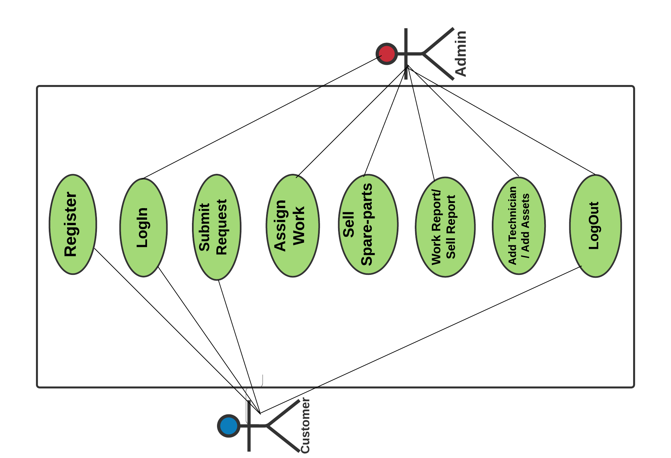
USE CASE DIAGRAM :-

Slide 9
Project Functionalities :-
For Customers →
Register
LogIn
View Profile
Submit Request
Request Status
Change Password
Log Out
For Admin →
LogIn
Dashboard
Assign work
Sell product
Add product / Add Technician
Work report / sell report
Change Password
Log Out

Slide 10
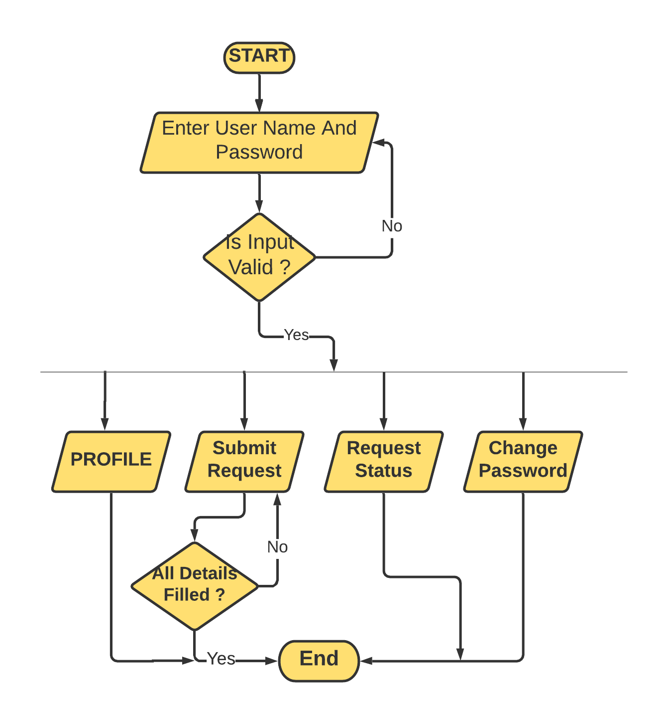
Activity Flow Diagram :-
For Customer →

Slide 11
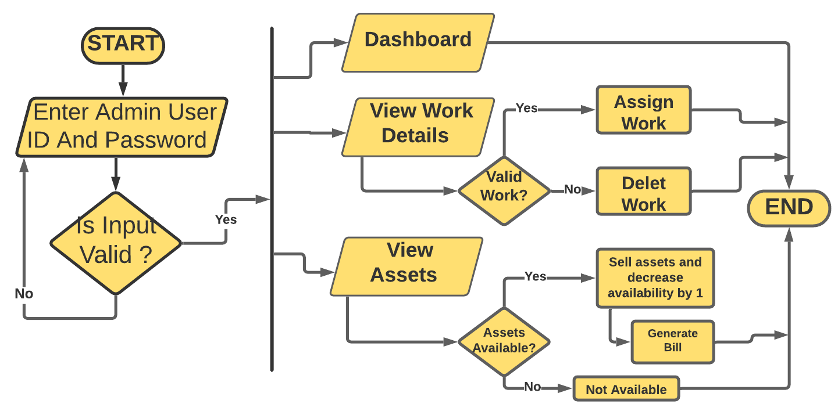
Flow Diagram :-
For Admin →

Slide 12
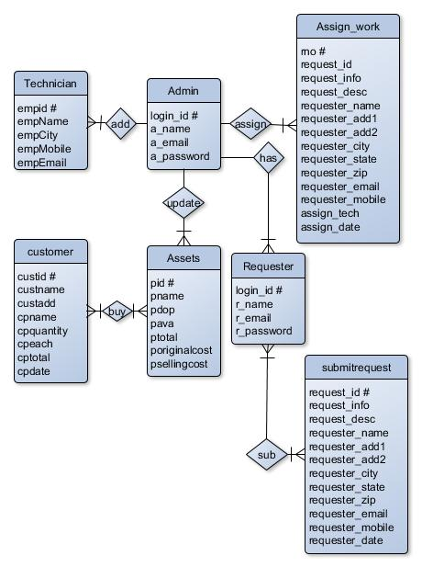
Database Design :-
E-R Diagram →

Slide 13
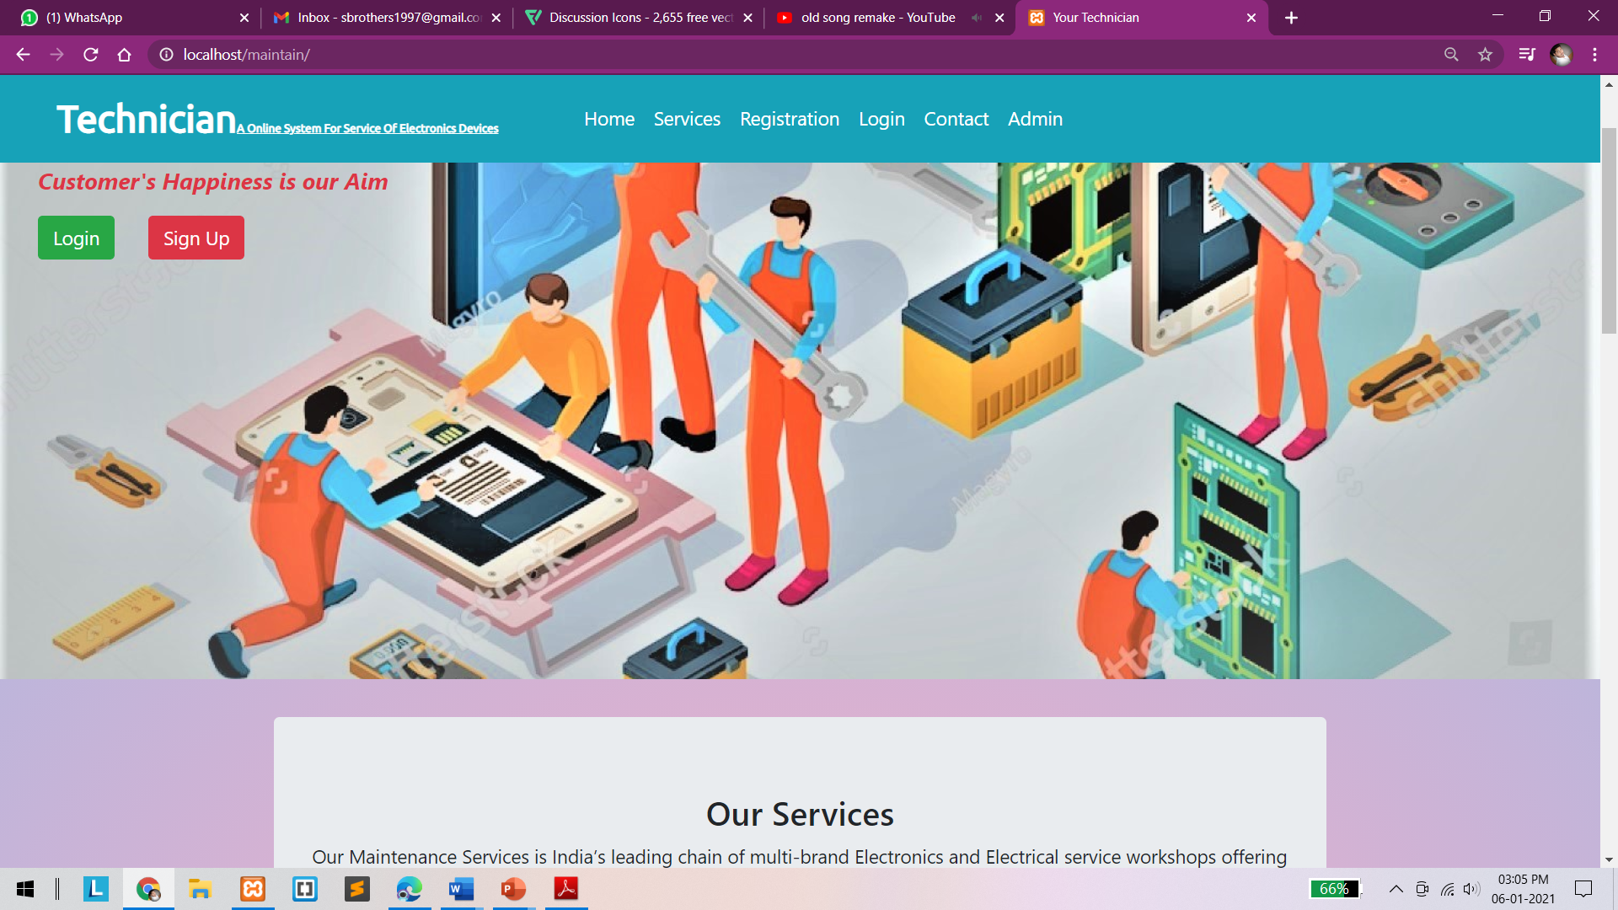
Home Page / Welcome Page -

Slide 14
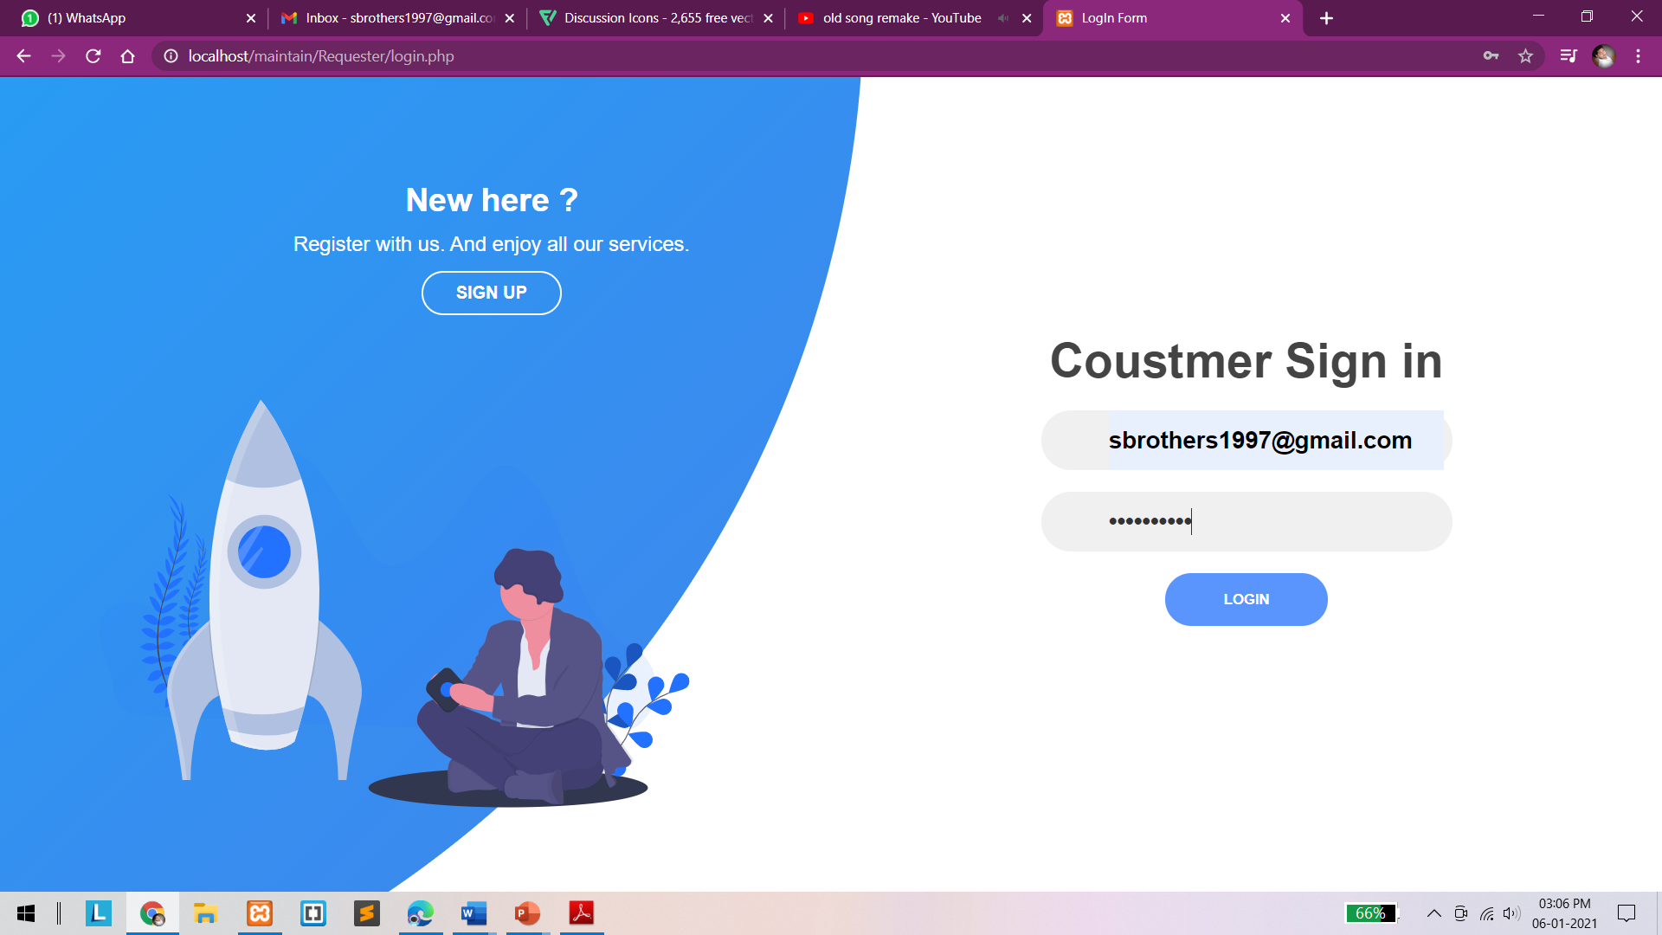
Signup and Login page -

Slide 15
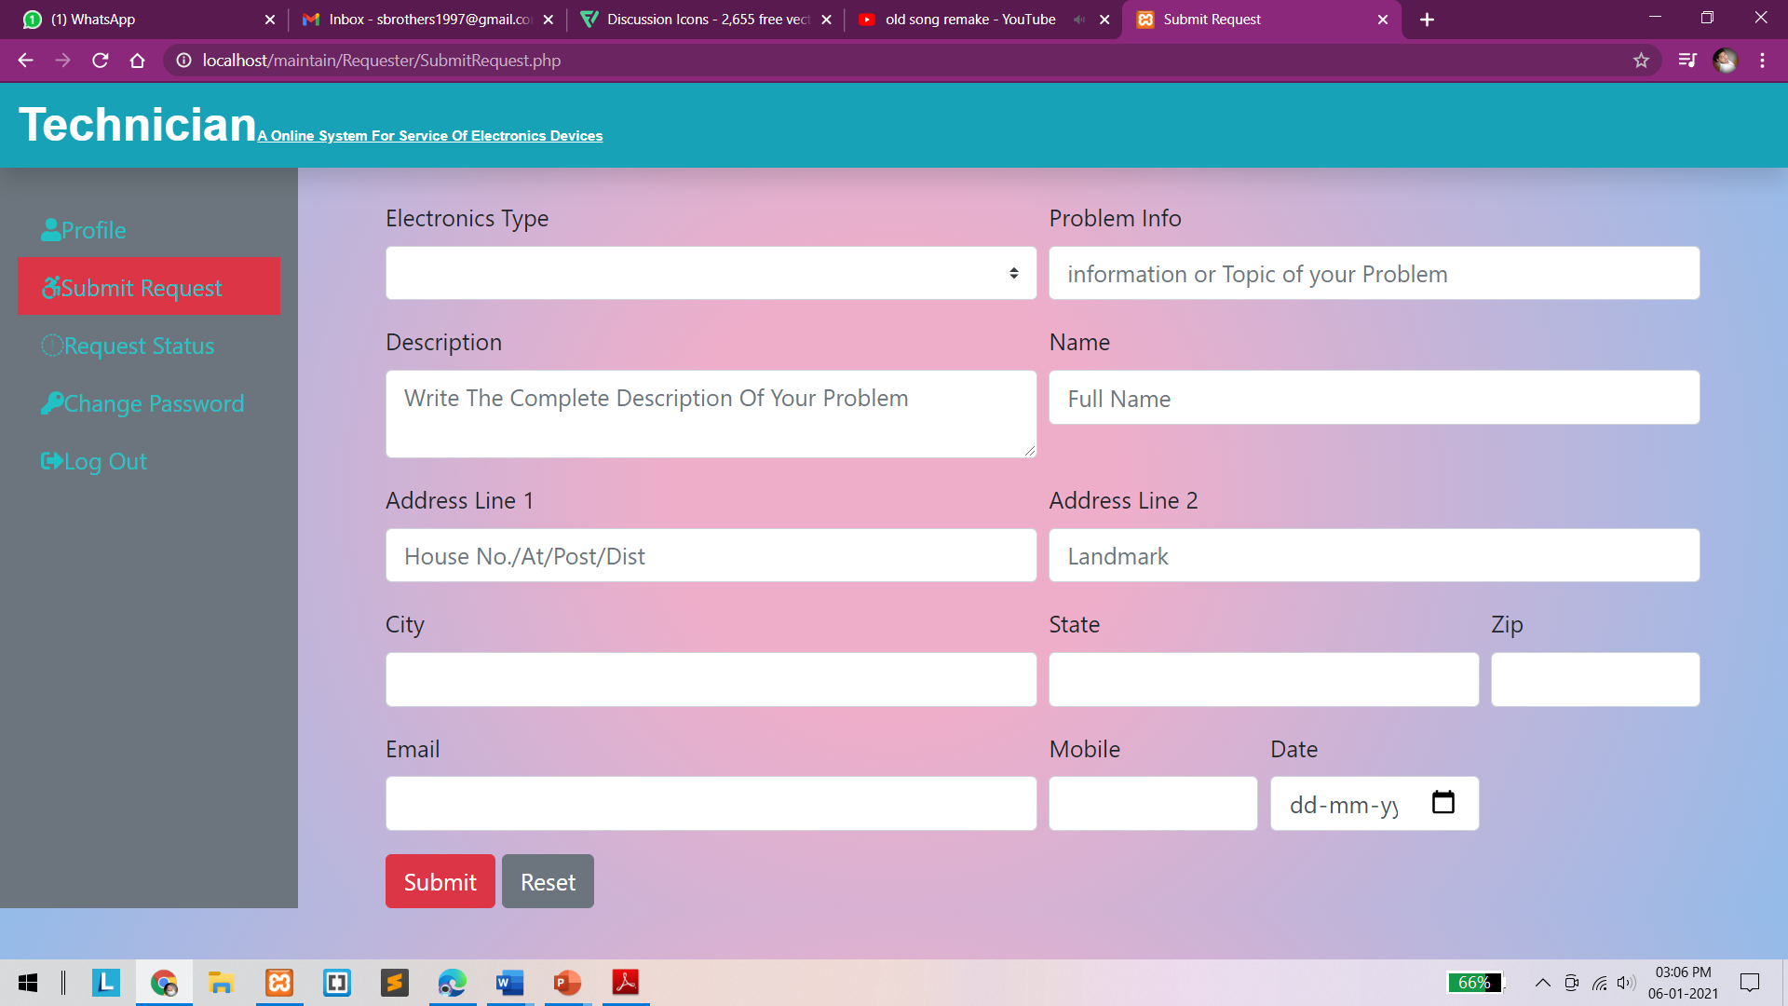
Customer Request page -

Slide 16
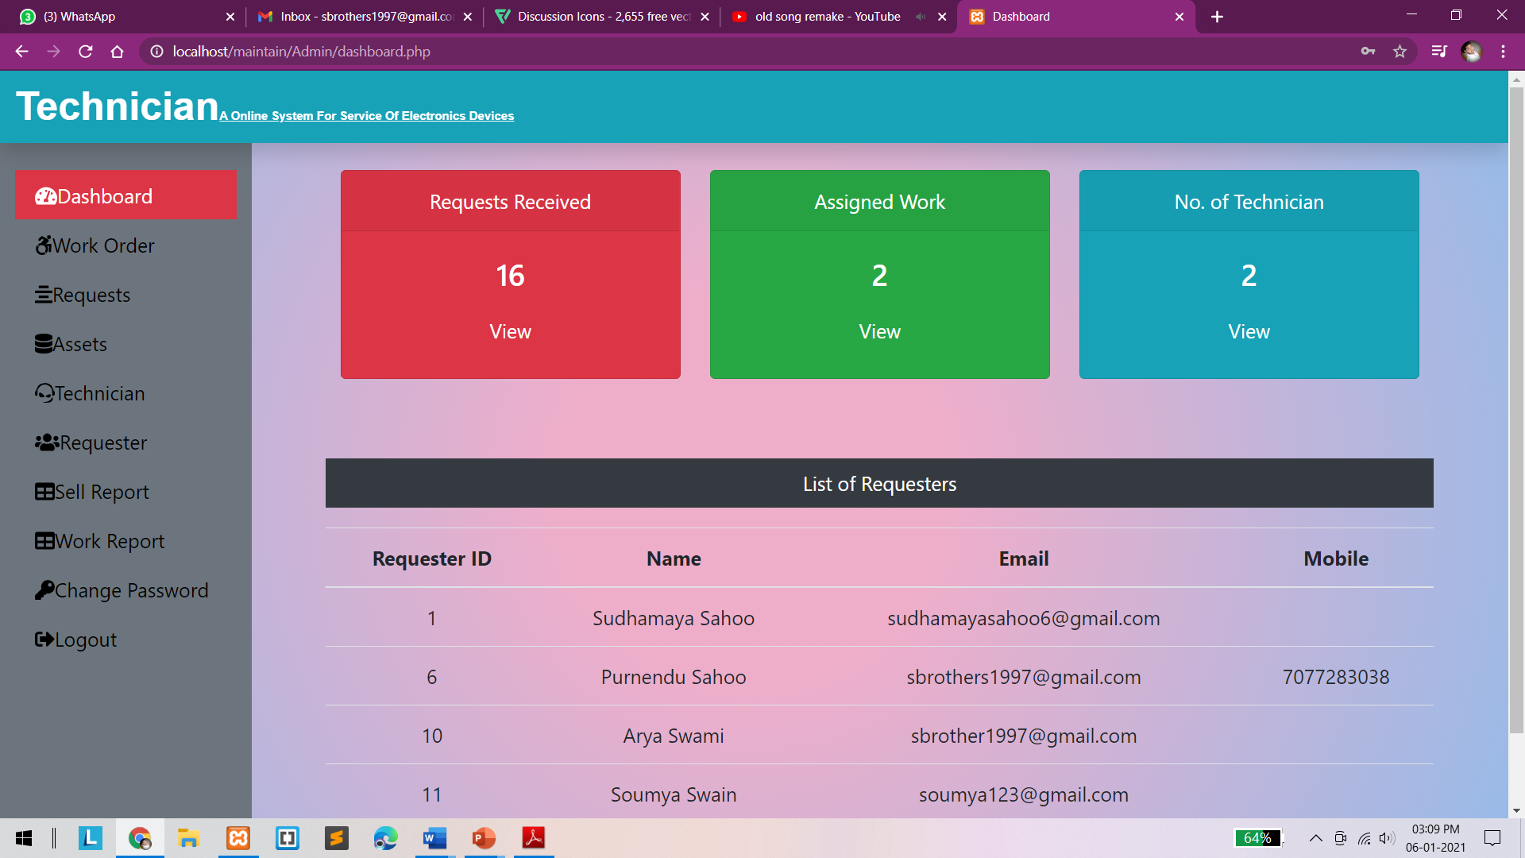
Admin Dashboard Page -

Slide 17
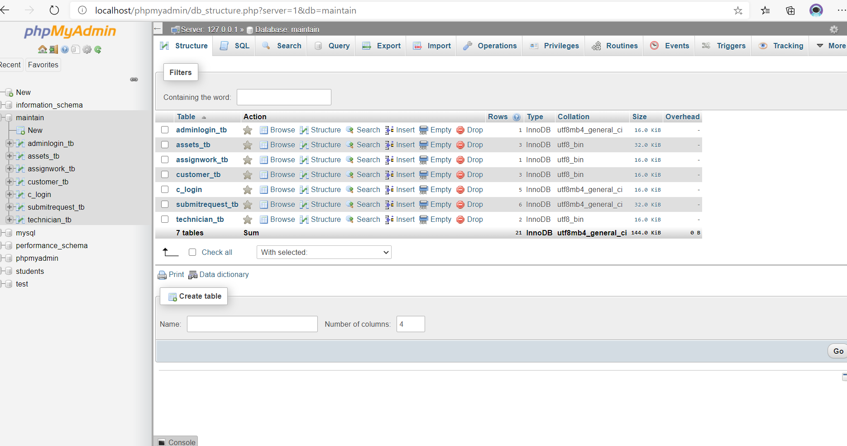
Database :-

Slide 18

Thank You
Any questions?

